Slide 1

Presentation on Java Programming (IT207G)
UNIT No. V- 1
Notes:
This template can be used as a starter file to give updates for project milestones.
Sections
Right-click on a slide to add sections. Sections can help to organize your slides or facilitate collaboration between multiple authors.
Notes
Use the Notes section for delivery notes or to provide additional details for the audience. View these notes in Presentation View during your presentation.
Keep in mind the font size (important for accessibility, visibility, videotaping, and online production)
Coordinated colors
Pay particular attention to the graphs, charts, and text boxes.
Consider that attendees will print in black and white or grayscale. Run a test print to make sure your colors work when printed in pure black and white and grayscale.
Graphics, tables, and graphs
Keep it simple: If possible, use consistent, non-distracting styles and colors.
Label all graphs and tables.

Slide 2
Java Applet
An applet is a Java program that runs in a Web browser. An applet can be a fully functional Java application because it has the entire Java API at its disposal..
An applet is a special kind of Java program that runs in a Java enabled browser..
In other words, we can say that Applets are small Java applications that can be accessed on an Internet server, transported over Internet, and can be automatically installed and run as apart of a web document.
To create an applet, a class must class extends java.applet.Applet class.
Notes:
Duplicate this slide as necessary if there is more than one issue.
This and related slides can be moved to the appendix or hidden if necessary.

Slide 3
Difference between Java Applet and Application
Parameters | Java Application | Java Applet
Meaning | A Java Application also known as application program that independently executes on the computer. | The Java applet works on the client side, and runs on the web browser.
Requirement of main( ) method | Its execution starts with the main( ) method only. | It does not require the use of any main() method. Java applet initializes through init( ) method.
Installation | We need to install the Java application first and obviously on the local computer. | Java applet does not need to be pre-installed.
Operation | It performs read and write tasks on a variety of files located on a local computer. | It cannot run the applications on any local computer.
Security | Java applications are pretty trusted, and thus, come with no security concerns. | Java applets are less reliable. So, they need to be safe.
Notes:
Duplicate this slide as necessary if there is more than one issue.
This and related slides can be moved to the appendix or hidden if necessary.

Slide 4
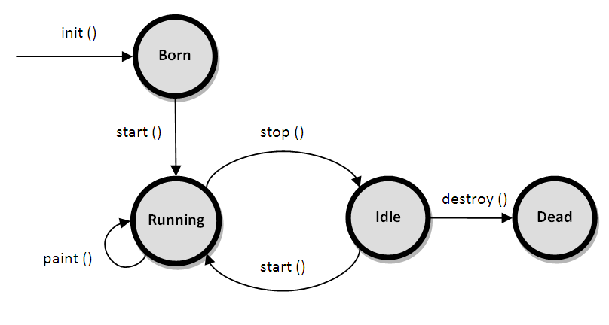
Applet Life Cycle
Notes:
Duplicate this slide as necessary if there is more than one issue.
This and related slides can be moved to the appendix or hidden if necessary.

Slide 5
Applet Life Cycle Methods
Applet life cycle methods control the life of applet and they called automatically. It has 4 life cycle methods and java.awt.Component class provides 1 life cycle methods for an applet.
pulic void init(): This method is called when the applet is first initialized. It is typically used for applet initialization tasks such as initializing the applet.
public void start(): This method is called when the applet is about to start running.
public void stop(): This method is called when the applet is about to stop running. It is called when the user navigates away from the page.
public void destroy(): This method is called when the applet is being destroyed.
public void paint(Graphics g): This method is called whenever the applet needs to be redrawn, such as when it is first displayed
Notes:
Duplicate this slide as necessary if there is more than one issue.
This and related slides can be moved to the appendix or hidden if necessary.

Slide 6
How to run an Applet?
There are two ways to run an applet
By html file on Web Browser
By appletViewer tool (for testing purpose) On command prompt
For Example:
c:\>javac First.java
c:\>appletviewer my.java
Notes:
Duplicate this slide as necessary if there is more than one issue.
This and related slides can be moved to the appendix or hidden if necessary.

Slide 7
Basic guide to creating an applet program in Java
Create a Java class: Start by creating a new Java class that extends the java.applet.Applet class.
Override the necessary methods: In your applet class, you'll need to override the init(), start(), stop(), and paint() methods.
Implement the applet's functionality: Inside the init() method, you can set up any initialization code for your applet. In the paint() method, you'll write code to draw graphics or display content on the applet's surface.
Create an HTML File: To run your applet in a appletviewer, you'll need to create an <applet> tag with the necessary attributes to specify the applet's class name and size in html separate file.
Compile and run code: Once you've written your applet class, compile it using the Java compiler (javac) and run (appletviewer)
Notes:
Duplicate this slide as necessary if there is more than one issue.
This and related slides can be moved to the appendix or hidden if necessary.

Slide 8
<applet> Tag
The HTML file need to create for writing <applet> tag
This way, you have two files that is HTML file and Java source file.
<html>
<body>
<applet code = "HelloApplet.class" width = "320"
height = "120">
</applet>
</body>
</html>
The code attribute of the <applet> tag is required. It specifies the Applet class to run.
Width and height are also required to specify the initial size of the panel in which an applet runs.
Notes:
Duplicate this slide as necessary if there is more than one issue.
This and related slides can be moved to the appendix or hidden if necessary.

Slide 9
Simple Applet program
import java.applet.Applet;
import java.awt.Graphics;
/* <applet code = "HelloApplet.class" width = "320"
height = "120"> </applet> */
public class MyApplet extends Applet
{
public void paint(Graphics g)
{
g.drawString(“A Simple Applet", 20, 20);
}
}
Notes:
Duplicate this slide as necessary if there is more than one issue.
This and related slides can be moved to the appendix or hidden if necessary.

Slide 10
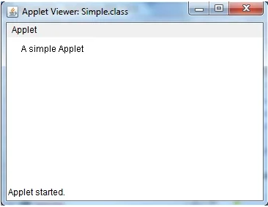
Command Prompt:
c:\>javac MyApplet.java
c:\>appletviewer Simple.java
Notes:
Duplicate this slide as necessary if there is more than one issue.
This and related slides can be moved to the appendix or hidden if necessary.

Slide 11
import java.applet.Applet;
import java.awt.Graphics;
public class StatusApplet extends Applet {
public void init() {
showStatus("Initializing applet...");
}
public void start() {
showStatus("Starting applet...");
}
public void stop() {
showStatus("Stopping applet...");
}
public void destroy() {
showStatus("Destroying applet...");
}
public void paint(Graphics g)
{
g.drawString("Hello, World!", 20, 20);
} }
/*<applet code="StatusApplet.class" width="300" height="200">
</applet>*/
Applet program to show all life cycle methods of applet

Slide 12
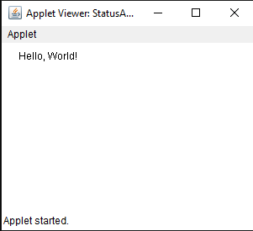
Command Prompt:
c:\>javac MyApplet.java
c:\>appletviewer Simple.java

Slide 13
Background and Foreground
import java.applet.Applet;
import java.awt.*;
public class MyApplet extends Applet{
public void init()
{
setBackground(Color.red);
setForeground(Color.green);
}
public void paint(Graphics g)
{
g.drawString(“Welcome to Applet", 20, 20);
}
}
/*<applet code=" MyApplet.class" width="300" height="300">
</applet> */
Notes:
Duplicate this slide as necessary if there is more than one issue.
This and related slides can be moved to the appendix or hidden if necessary.

Slide 14
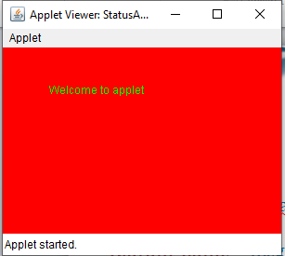
Command Prompt:
c:\>javac MyApplet.java
c:\>appletviewer MyApplet.java
Notes:
Duplicate this slide as necessary if there is more than one issue.
This and related slides can be moved to the appendix or hidden if necessary.

